Slide 1

MOVING CHARGES AND MAGNETISM

Slide 2
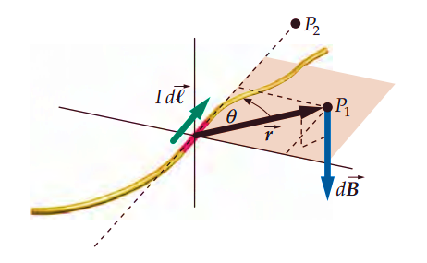
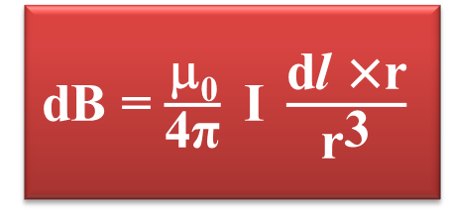
BIOT-SAVART LAW
MAGNETIC FIELD DUE TO A CURRENT ELEMENT, BIOT-SAVART LAW
Biot- Savart law gives a relation between the current and the magnetic field.
The Biot-Savart law asserts that the magnetic field dB due to an element dl carrying a steady current I at a point P at a distance r from the current element is
dB = $\frac{\text{μ}\text{0}}{\text{4}\text{π}} \text{I} \frac{\text{d}\text{l} \text{×}\text{r}}{{\text{r}}^{\text{3}}}$

Slide 3





Thus, in vector notation,
dB α$\frac{\left|\text{d}l\right|\text{×}\text{r}}{{\text{r}}^{\text{3}}}$
= $\frac{\text{μ}\text{0}}{\text{4}\text{π}}\frac{\left|\text{d}l\right|\text{×}\text{r}}{{\text{r}}^{\text{3}}}$
dB = $\frac{\text{μ}\text{0}}{\text{4}\text{π}}\frac{\left|\text{d}l\right|\text{sin}\text{θ}}{{\text{r}}^{\text{2}}}$
where $\frac{\text{μ}\text{0}}{\text{4}\text{π}}$ = 10⁻⁷ Tm/A
We call µ₀ the permeability of free space.
dB = $\frac{\text{μ}\text{0}}{\text{4}\text{π}} \text{I} \frac{\text{d}l\text{ ×}\text{r}}{{\text{r}}^{\text{3}}}$
This is known as Biot–Savart law. The direction is given by right hand screw rule.

Slide 4
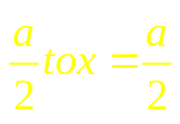
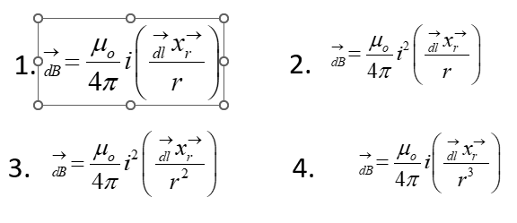
Qn 1: A straight section PQ of a circuit lies along the X-axis from x=-
and carries a steady current i. The magnetic field due to the section PQ at a point X=+a will be
1. Proportional to a 2. Proportional to a²
3. Proportional to 1/a 4. Zero
Qn 2: The magnetic field dB due to a small current element at a distance
and element carrying I is

Slide 5
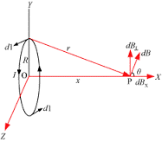


Magnetic field on the axis of a circular current loop:
Consider a conducting element dl of the loop as shown in figure.
The magnitude dB of the magnetic field due to dl is given by the
Biot-Savart law as
dB = $\frac{\text{μ}\text{0}}{\text{4}\text{π}}\text{I} \frac{\text{d}\text{l}\text{ ×}\text{r}}{{\text{r}}^{\text{3}}}$
Now, ${\text{r}}^{\text{2}}\text{ = }{\text{X}}^{\text{2}}\text{+ }{\text{R}}^{\text{2}}$

Slide 6





Since dl and r are perpendicular to each other ,
dB = $\frac{\text{μ}\text{0}}{\text{4}\text{π}}\frac{\left|\text{d}l\right|}{\left({\text{x}}^{\text{2}}\text{+}{\text{r}}^{\text{2}}\right)}$
From figure,
cosθ = $\frac{\text{R}}{{\left({\text{x}}^{\text{2}}\text{+}{\text{R}}^{\text{2}}\right)}^{1/2}}$
∴dB_{x}= dBcosθ = $\frac{\text{μ}\text{0}}{\text{4}\text{π}}\frac{\left|\text{d}l\right|}{\left({\text{x}}^{\text{2}}\text{+}{\text{r}}^{\text{2}}\right)}\frac{\text{R}}{{\left({\text{x}}^{\text{2}}\text{+}{\text{R}}^{\text{2}}\right)}^{1/2}}$
∴dB_{x}= dBcosθ = $\frac{\text{μ}\text{0}}{\text{4}\text{π}} \frac{\left|\text{d}l\right|\text{R}}{{\left({\text{x}}^{2}\text{+}{\text{R}}^{2}\right)}^{3/2}}$

Slide 7
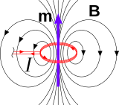


∴$\vec{\text{B}}\text{=}\text{Bx} \hat{\text{i}}\text{=}\frac{\text{μ}\text{0}\text{I}{\text{R}}^{\text{2}}}{\text{2}{\left({\text{x}}^{\text{2}}\text{+}{\text{R}}^{\text{2}}\right)}^{\text{3/2}}}\hat{\text{i}}$
At the centre of the loop, x=0. Hence,
∴$\vec{\text{B}\text{0}}\text{=}\frac{\text{μ}\text{0}\text{I}}{\text{2}\text{R}}\hat{\text{i}}$
The magnetic field lines due to a circular wire, form closed loops as shown in figure.
The direction of magnetic field is given by the right hand thumb rule.

Slide 8




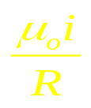
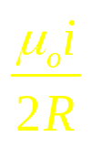
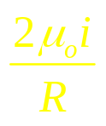
Qn 3. A current I ampere flows in a circular arc of wire whose radius is R, which subtend an angle 3
radian at its centre. The magnetic induction B at the centre is
1.
2.
4.
3.
Qn 4. A direct current is passing through a wire. It is bent to form a coil of one turn. Now it is further bent to form a coil of two turns but at smaller radius. The ration of the magnetic induction at the centre of this coil and at the centre of the coil of two turn is
1. 1:4 2. 4:1 3. 2:1 4. 1:1

Slide 9
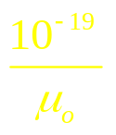

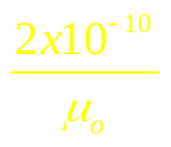

Qn 5 : A helium nucleus makes a full rotation in a circle of radius 0.8 metre in two seconds. The value of the magnetic field B at the centre of the circle will be
2. 10⁻¹⁹
3. 2x10⁻¹⁰
4.
1.
Qn. 6 : The magnetic induction at the centre Q in the figure shown is
1. 2. 3. 4.

Slide 10
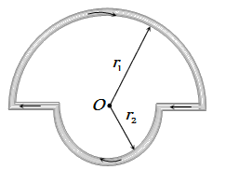
Qn 7. In the figure shown there are two semicircles of radii r₁ and r₂ in which a current I is flowing. The magnetic induction at the centre O will be
1. 2. 3. 4.

Slide 11
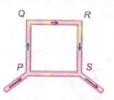
Qn 8. The magnetic field at the centre of coil of n turn, bent in the form of a square of side 2l, carrying current I, is
1. 2. 3. 4.
Qn 9. PQRS is a square loop made of uniform conducting wire the current enters the loop at P and leaves at S. Then the magnetic field will be
Maximum at the centre of the loop
2. Zero at the centre of loop
3. Zero at all points inside the loop 4. Zero at all points outside of the loop

Slide 12

AMPERE’S RIGHT HAND GRIP RULE
&
MAXWELL’S CORK SCREW RULE
A current carrying conductor produces a magnetic field around the conductor represented by concentric closed magnetic field lines. The direction of $\vec{\text{B}}$ and direction of flow of current “I” can be founded by the following.
AMPERE’S RIGHT HAND GRIP RULE
MAXWELL’S CORK SCREW RULE

Slide 13
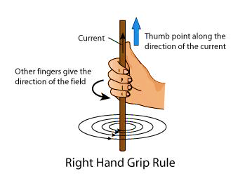
Ampere’s Right hand Grip rule:
If a straight current carrying conductor is held with a right hand with the thumb indicating the direction of flow of current in it, then the curled fingers around it forming the grip indicate the direction of the associated magnetic field lines.

Slide 14
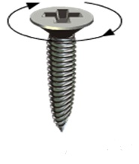
Maxwell’s cork screw rule:
If the translational advancement of the screw directs in the direction of the flow of current in a conductor then rotational motion of the screw directs in the direction of magnetic field lines and vice-versa.
The direction of rotation gives the direction of the magnetic field
Direction of current
Maxwell’s screw rule

Slide 15



Magnetic field, Lorentz force :
A static charge cannot produce magnetic field but only a moving change can do it. Hence the force on a charge q in a magnetic field $\vec{\text{B}}$ moving with a velocity $\vec{v}$is
$$\vec{\text{F}}\text{magnetic}\text{ = }\text{q}\text{ [}\vec{\text{v}}\text{x}\vec{\text{B}}\text{] = }\text{q} \text{v} \text{B} \text{sin}\text{θ }\hat{\text{n}}$$
Where θ is the angle between $\overline{\text{v}}$and $\overline{\text{B}}$ the magnitude of magnetic field B is 1 SI unit, when the force acting on a unit charge(1 C), moving perpendicular to B with the speed of 1m/s , is 1N.

Slide 16
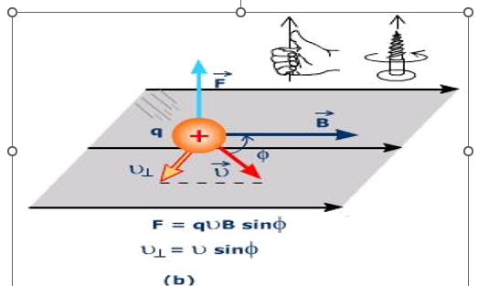
F_{m} = 0 if v = 0
Only a moving charge feels the magnetic force
F_{m}=0 if θ= $0^{0}$ or ${180}^{0}$ (i.e., if $\vec{v}$&$\vec{\text{B}}$ are parallel or anti parallel )
F_{m} acts always in a direction perpendicular to both the velocity & the magnetic field.

Slide 17

Now the force on an electric charge(q) in motion due to both electric E (r) & magnetic field B ( r ) is
F= q$\vec{\text{E} }$ (r) + q$\vec{\text{v} }$×$\vec{\text{B} }$ (r) = q$\left\{\vec{\text{E} }\text{ (}\text{r}\text{) + }\vec{\text{v} } \text{×} \vec{\text{B} }\text{ (}\text{r}\text{)}\right\}$
F = F_{electric} + F_{magnetic} . This is called Lorentz force.
Unit of B(tesla): B = $\frac{\text{F}}{\text{qv}}$
B=1T, when F=1N, R=1C and v=1m/s
Tesla is defined as the magnitude of magnetic field when a force of 1N acts on a charge of 1C moving with a velocity of 1 m/s.
Non-S.I. unit of B is 1 gauss = 10⁻⁴T .

Slide 18

Magnetic force on a current carrying conductor
Consider a current carrying straight rod of uniform cross sectional area A & length l.
Let the number of mobile charge carriers crossing a unit volume be n. Then, the total number of mobile charge carries in it is Al.
Let $\overline{Vd}$be the average drift velocity of each mobile carrier. Now, in the presence of an external magnetic field $\vec{B}$, the force on these carriers.

Slide 19







F = (nAl) q$\vec{vd}$ × $\vec{B}$ = [$\vec{I}$ A l] × $\vec{B}$ = I( $\vec{l}×\vec{B}$ )
Where q is the value of the charge on a carrier.
Now, nq$\vec{vd}=\vec{I},$ the current density &$\left|nq\vec{vd}\right| A=I,$is the current.
thus, $\vec{\text{F}}\text{ = }\text{I}\text{(} \vec{\text{l}}\text{×}\vec{\text{B}}$ )
Where $\vec{l}$ is a vector of magnitude 1 &with a direction identical to the current I.
If wire is of any arbitrary shape then the Lorentz force on the wire is given as d$\vec{l}j$
$$\vec{\text{F}}\text{ =}$$
$$\sum_{\text{j}}{\text{d}\vec{\text{l}}\text{j}\text{×}\vec{\text{B}}}$$
Where d$\vec{l}j$is a small element of the wire.

Slide 20
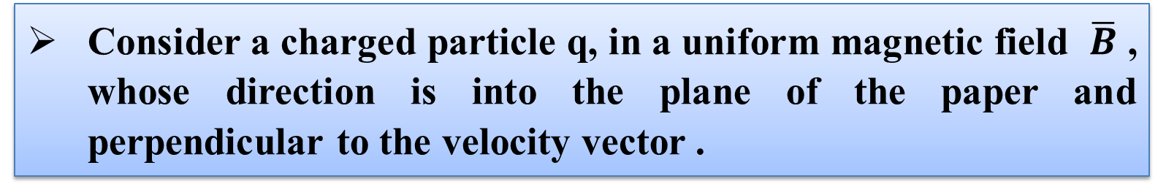
Motion in a Magnetic field
Consider a charged particle q, in a uniform magnetic field $\overline{B}$ , whose direction is into the plane of the paper and perpendicular to the velocity vector .
So, no work is done and no change in the magnitude of the velocity is produced(though the direction of momentum may be changed).

Slide 21
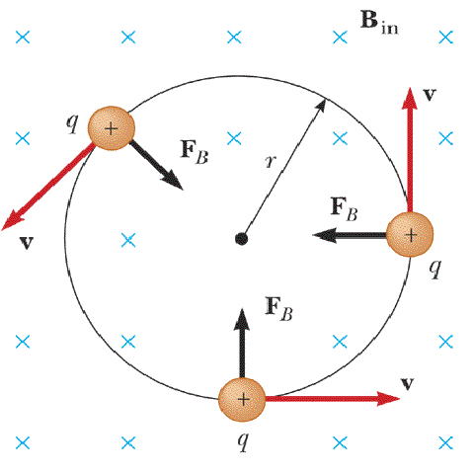
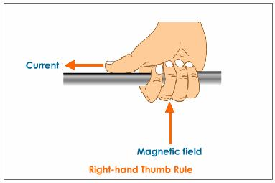
Consider 3 points A, B, C at which, we will find direction of force on the charge q .
By RIGHT HAND THUMB RULE OR RIGHT HAND SCREW RULE, if initially q is at A , moving towards right , then F will be towards up.
C
B
A

Slide 22


If q is at B moving towards up, F will be towards left
If q is at C, the direction of F will be as shown in figure.
Now, if $\vec{v}$ has a component along $\vec{B}$ , this component remains unchanged as the motionalong $\vec{B}$will not be effected by the magnetic field.
The motion in a plane perpendicular to $\vec{B}$is as before a circular one.
Hence, the charged particle will produce a helical motion.

Slide 23
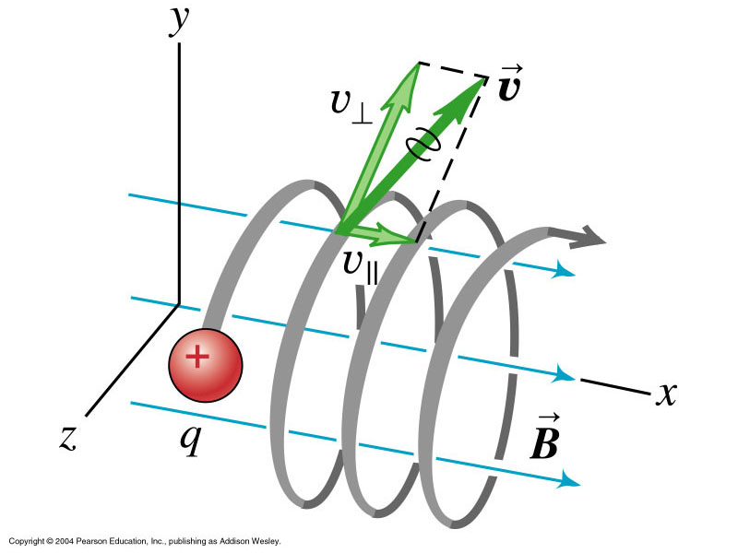


Since this force is centripetal in nature,
F = $\frac{\text{m}{\text{v}}^{\text{2}}}{\text{r}}$→ (1)
F = qvB → (2)
From equation 1 and 2
Helical motion
r = $\frac{\text{mv}}{\text{qB}}$ = $\frac{\text{p}}{\text{qB}}$→ (3)
r is the radius of the circle described by the charged particle q .
Larger the momentum, larger is the radius and bigger is the circle described.

Slide 24



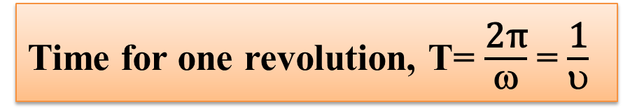
For frequency υ of rotation, v = ω r
$\frac{\text{v}}{\text{r}}\text{= }\text{ω}$⇒ $\frac{\text{v}}{\text{r}}\text{=} \text{2}\text{π}\text{υ}$→ (4)
From equation (3) and (4)
$$\text{2}\text{π}\text{υ= }\frac{\text{Bq}}{\text{m}}$$
$$\text{υ= }\frac{\text{qB}}{\text{ 2}\text{π}\text{m}}$$
Time for one revolution, T= $\frac{\text{2}\text{π}}{\text{ω}}$ = $\frac{\text{1}}{\text{υ}}$

Slide 25

If there is a component of velocity parallel to the magnetic field denoted by V₁₁, it will make a particle move along the field and the path of the particle would be a helical one.
PITCH (p) is the distance moved along the magnetic field in one rotation, given as
p = v₁₁T = $\frac{\text{2}\text{π} \text{mv}\text{11}}{\text{qB}}$
The radius of the circular component of the motion of charged particle with in the uniform magnetic field is called the radius of helix.

Slide 26
Qn 10. A uniform electric field and a uniform magnetic field are produced, pointed in the same direction. An electron is projected with its velocity pointing in the same direction
1. The electron will turn to its right
2. The electron will turn to its left
3. The electron velocity will increase in magnitude
4. The electron velocity will decrease in magnitude
Qn 11. An electron has mass 9 x 10⁻³¹ kg and charge 1.6 x 10⁻¹⁹ C is moving with a velocity of 10⁶ m/s, enters a region where magnetic field exists. If is describes a circle of radius 0.10m, the intensity of magnetic field must be
1. 1.8 x 10⁻⁴ T 2. 5.6 x 10⁻⁵ T
3. 14.4 x 10⁻⁵T 4. 1.3 x 10⁻⁶T

Slide 27
Qn 12. A proton is moving along Z-axis in a magnetic field. The magnetic field is along X-axis. The proton will experience a force along
1. X-axis 2. Y-axis 3. Z-axis 4. Negative Z-axis
Qn 13. A proton (mass = 1.67 x 10⁻²⁷ kg and charge 1.6 x 10⁻¹⁹ C)
Enters perpendicular to a magnetic field of intensity 2 weber/m² with a velocity 3.4x10⁷ m/sec. The acceleration of the proton should be
1. 6.5 x 10¹⁵m/sec² 2. 6.5 x 10¹³m/sec²
3. 6.5 x 10¹¹ m/sec² 4. 6.5 x 10⁹ m/sec²

Slide 28
Qn 14. Assertion: If a charged particle is moving in perpendicular uniform magnetic field, its kinetic energy does not change
Reason: Velocity of charge particle is not changing in magnetic field
1. If both assertion and reason are true and the reason is the correct explanation of the assertion.
2. If both assertion and reason are true but reason is not the correct explanation of the assertion.
3.If assertion is true but reason is false.
4.If assertion is false but reason is true
Qn 15. Lorentz force can be calculated by using the formula
    1. 2.
3. 4.

Slide 29
Qn 16. The charge on a particle Y is double the charge on particle. X these two particles X and Y after being accelerated though the same potential difference enter a region of uniform magnetic field and describe circular paths of radii R₁ and R₂ respectively. The ratio of the mass of X to that of Y is
1. 2. 3. 4.
Qn 17. An electron enters a region where magnetic (B) and electric (E) fields are mutually perpendicular to one another, then
1. It will always move in the direction of B
2. It will always move in the direction E
3. It always possess circular motion
4. It can go undeflected also

Slide 30
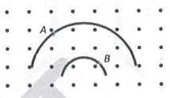
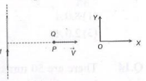
Qn 18. Two particles A and B of masses m_{A} and m_{B} respectively and having the same charge are moving in a plane. A uniform magnetic field exists perpendicular to this plane. The speeds of the particles are V_{a} and VB respectively, and the trajectories are as shown in the figure Then
1. m_{A} V_{A} < m_{B}V_{B} 2. m_{A} v_{A} > m_{B} V_{B}
3. m_{A} < m_{B} and V_{A} < V_{B} 4. m_{A}=m_{B} and V_{A}=V_{B}
Qn 19. A very long straight wire carries a current I. At the instant when a charge +Q at point P has velocity V, as shown, the force on the charge is
1. Opposite to OX 2. Along OX
3. Opposite to OY 4. Along OY
Qn 20. A deuton of kinetic energy 50 keV is describing a circular orbit of radius 0.5 metre in a plane perpendicular to magnetic field B. The kinetic energy of the proton that describes a circular orbit of radius 0.5 metre in the same plane with the same B is
1. 25 keV 2. 50 keV 3. 200 keV 4. 100 keV

Slide 31
Ampere’s circuital law
The line integral of B . dl taken over the entire closed path of induction in a given perpendicular plane is equal to µ₀ times the total current enclosed in the closed path
∮ B . dl
=
μ₀I
Consider a long straight current carrying conductor emerging out of and perpendicular to the plane of the paper.
The magnetic lines are in the form of concentric circles centered on the wire.

Slide 32

The Solenoid
A Solenoid is a long wire wound in a helical form where the turns are closely placed .
Each turn can be considered as a circular loop which carries current.

Slide 33
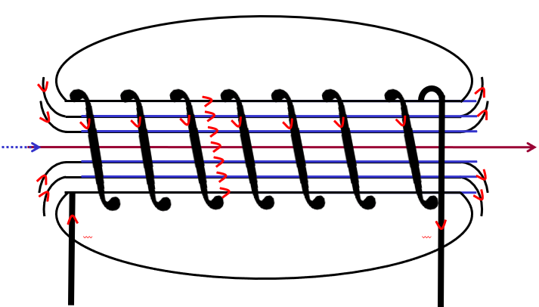
Outside the solenoid, the magnetic field is very small as compared to the field inside and may be assumed zero.

Slide 34
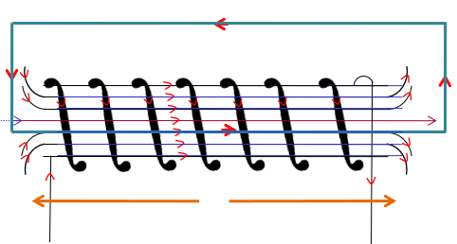
Magnetic field in the interior of a
long solenoid
S
B.dl
= 0
Let
I = current through the solenoid.
P
and
0
S
we get,
Q
R
S
P
∫
∴
B.dl
=
∫
B.dl
+
∫
+
∫
B.dl
+
∫
B.dl
we get,
P
Q
R
S
=
Q
Q
Now,
∫
B.dl
=
∫
μ₀ × total current enclosed by PQRSP
i.e.
=
∴
P
P
Bl
=
μ₀ × n × current through each turn.

Slide 35
∴
Bl
=
μ₀
_{n}
I
This is the expression for magnetic induction inside a long solenoid
n
∴
B
=
μ₀
I
l
n
 
=
N
l
Where N = number of turns per unit length
At the point near the end of a solenoid, the magnetic field induction is found to be μ₀n I/2.

Slide 36
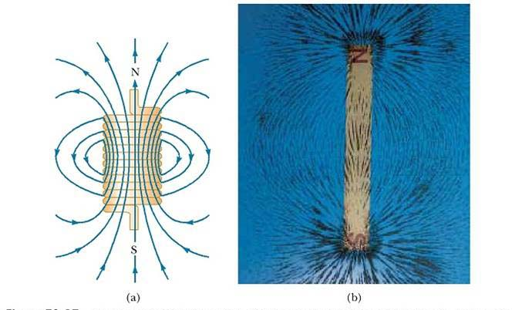
The magnetic field of a finite solenoid

Slide 37
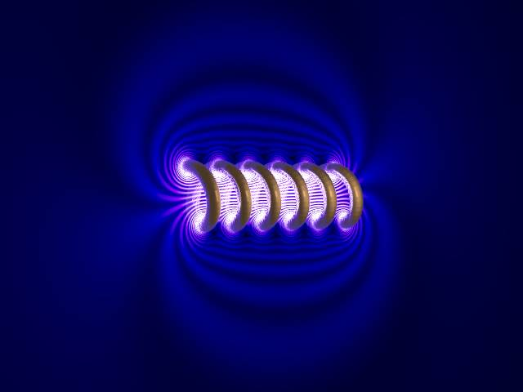
In a solenoid the magnetic field is STRONG and UNIFORM.
On the other hand, outside the solenoid, the field is non-uniform.
As one starts moving away from the solenoid, the field diminishes and the solenoid looks like a cylindrical metal sheet.

Slide 38
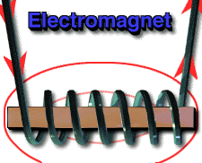
The direction of the field is given by RIGHT HAND RULE.
The solenoid is commonly used to obtain a uniform magnetic field.

Slide 39
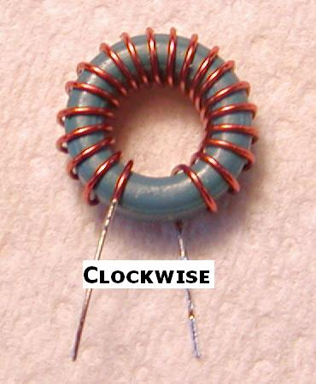
TOROID
A toroid is a hallow circular ring on which a large number of turns of a wire are closely wound.
It can be viewed as a solenoid which has been bent into a circular shape to close on itself.
The field B inside the toroid is constant in magnitude for the ideal toroid of closely wound turns.
B
This is a toroid.

Slide 40
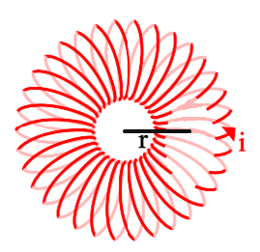

Consider an ideal toroid.
Let
I
=
Current through the toroid.
r
=
Mean radius of toroid
I
P
Draw an amperean loop passing through P.
n
=
We have to calculate magnetic field, ‘B’
at different point.
∮ $\overline{\text{B}}$. $\overline{\text{d}\text{l}}$
=
μ₀I
∴
dl ≠ 0
(0 = I ∴)
∴
∮ B . dl
=
0
∴
Magnetic field B in the empty space enclosed by Toroid is zero.

Slide 41
Point P is outside the toroid.
P
Let it be a concentric circle.
We see that the current is going in the plane
and coming out of plane.
∴
Current through loop is zero.
∴
Magnetic field outside toroid is zero.

Slide 42
→
Point P is within coil of toroid
B
→
dl
Let it be a concentric circle of radius r .
P
Current through
the loop
n × current through
each turn (i)
=
Magnetic field ‘B’ is along the loop hence
magnetic field is tangential to the loop.
→
→
Angle between B and dl
is 0 everywhere on this path.

Slide 43
According to Ampere’s circuital law
→
→
∮
B
.
d
=
μ₀I

θ
=
0⁰
∴
∮
Βd
cosθ
=
μ₀I
∴
cos θ
=
1
∴
Β
∮
d
=
μ₀I
∴
Β (2πr)
=
μ₀I
[  ∮ d = 2πr]
∴
Β
∮
d
=
μ₀ × total current enclosed by the closed path.
=
μ₀ × n × current through
each turn.
∴
Β (2πr)
=
μ₀ × n × I

Slide 44
n
∴
Β
=
μ₀
I
2πr
∴
Β_{in}
=
μ₀ NI
n
Θ
Ν
=
2πr
Where N
=
number of turns per unit length.

Slide 45
Let he magnitude of the magnetic field along loop1 be B₁
Then, in Ampere’s circuital law L=2πr₁
The loop encloses no current, so I_{e}=0
B₁(2πr₁)=μ₀(0), B₁=0
Thus, the magnetic field at any point in the open space inside the toroid is zero.

Slide 46

Qn 21. If a long hollow copper pipe carries a direct current, the magnetic field associated with the current will be
1. Only inside the pipe 2. Only outside the pipe
3. Neither inside nor outside the pipe 4. Both inside and outside the pipe
Qn 22. There are 50 turns of a wire in every cm length of a long solenoid. If 4 ampere current is flowing in the solenoid, the approximate value of magnetic field along its axis at an internal point and at one end will be respectively
Qn 23. A solenoid is 1.0 metre long and it has 4250 turns. If a current of 5.0 ampere is flowing through it, what is the magnetic field at its centre
1. 5.4 x 10⁻² weber/m² 2. 2.7 x 10⁻²weber/m²
3. 1.35 x 10⁻² weber/m² 4. 0.675 x 10⁻² weber/m²

Slide 47

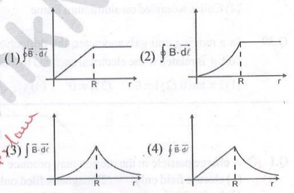
Qn 24. A cylindrical wire of radius R is carrying current I uniformly distributed over its cross-section. If a circular loop of radius ‘r’ is taken as amberina loop, then the variation value of over this loop with radius r of loop will be best represented
Qn 25. A current I flows along the length of an infinitely long, straight, thin walled pipe. Then
1. The magnetic field at all points inside the pipe is the same, but not zero
2. The magnetic field at any point inside the pipe is zero
3. The magnetic field is zero only on the axis of the pipe
4. The magnetic field is different at different points inside the pipe

Slide 48
Qn 26. From Ampere’s circuital law for a long straight wire of circular cross-section carrying a steady current, the variation of magnetic field in the inside and outside region of the wire is:
1. A linearly increasing function of distance up to the boundary of the wire and then linearly decreasing for the outside region.
2. A linearly increasing function of distance r up to the boundary of the wire and then decreasing one with 1/r dependence for the outside region.
3. A linearly decreasing function of distance up to the boundary of the wire and then a linearly increasing one for the outside region.
4. Uniform and remains constant for both the regions

Slide 49
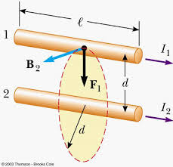
Force between two parallel currents carrying conductors
According to Biot- Savart’s law, there exists a magnetic field due to a conductor carrying current.
Further, an external magnetic field will exert a force on a current carrying conductor.
Thus, two current carrying conductors placed near each other will exert magnetic force on each other.

Slide 50
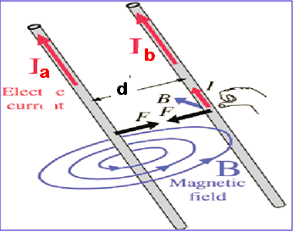


“a” and “b” are two long parallel conductors.
They carry parallel currents I_{a} and I_{b} respectively.
Conductor ‘a’ produces the same magnetic field$\vec{\text{B}\text{a}}$ , at all points along ‘b’.
From Ampere’s Circuital law,
B_{a} = $\frac{\text{μ}\text{0}\text{I}\text{a}}{\text{2}\text{π}\text{d}}$
Electric current

Slide 51


Conductor ‘b’ carrying I_{b} will experience a force due to B_{a}
Then, the force on ‘a’ due to ‘b’ is
F_{ba}= I_{b}LB_{a}
= $\frac{\text{μ}\text{0}\text{I}\text{a}\text{I}\text{b}\text{L}}{\text{2}\text{π}\text{d}}$
Similarly
F_{ba}= -I_{a}LB_{b} = - $\frac{\text{μ}\text{0}\text{I}\text{a}\text{I}\text{b}\text{L}}{\text{2}\text{π}\text{d}}$

Slide 52

Thus, F_{ba} = - F_{ab}
Therefore, PARALLEL CURRENTS ATTRACT AND ANTIPARALLEL CURRENTS REPEL(opposite to what we find in Electrostatics).
F_{ba} = F_{ab}
= $\frac{μ_{0}I_{a}I_{b}L}{2πd}$

Slide 53

AMPERE ( The SI unit of current ):
Let f_{ba}= $\frac{\text{F}\text{ba}}{\text{L}}$= $\frac{\text{μ}\text{0}\text{I}\text{a}\text{I}\text{b}}{\text{2}\text{π}\text{d}}$, then
I_{a}=I_{b} (is said to be) = 1 Ampere
The ampere is the value of that steady current which, when maintained in each of the two very long, straight, parallel conductors of negligible cross–section, and placed one meter apart in vacuum, would produce on each of these conductors a force = F_{ba}
f_{ba} = 2x10⁻⁷ N per metre length.

Slide 54
Qn 27. Two long and parallel wires are at a distance of 0.1 m and a current of 5 A is flowing in each of these wires. The force per unit length due to these wires will be
1. 5 x 10⁻⁵ N/m 2. 5 x 10⁻³ N/m
3. 2.5 x 10⁻⁵ N/m 4. 2.5 x 10⁻⁴ N/m
Qn 28. Two parallel wires in free space are 10cm apart and each carries a current of 10 A in the same direction. The force one wire exerts on the other per metre of length is
1. 2 x 10⁻⁴ N, attractive 2. 2 x 10⁻⁴ N, repulsive
3. 2 x 10⁻⁷ N, attractive 4. 2 x 10⁻⁷ N, repulsive

Slide 55
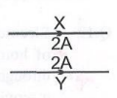
Qn 29. In given figure, X and Y are two long straight parallel conductors each carrying a current of 2 A. The force on each conductor is F newtons. When the current in each is changed to 1A and reversed in direction, the force on each is now
1. F/4 and unchanged in direction 2. F/2 and reversed in direction
3. F/2 and unchanged in direction 4. F/4 and reversed in direction

Slide 56
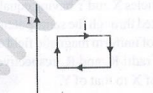
Qn 30. A rectangular loop carrying a current I is situated near a long straight wire such that the wire is parallel to one of the sides of the loop and the plane of the loop is same of the left wire. If a steady current is established in the wire as shown in the (fig) the loop will
1. Rotate about an axis parallel to the wire
2. Move away from the wire
3. Move towards the wire
4. Remain stationary

Slide 57
Qn 31. Statement-I: Parallel wires carrying currents in same direction attracts each other due to magnetic force.
Statement-II: Two electron beams moving parallel to each other repel each other due to electric force.
ASSERTION REASON TYPE QUESTION:
Read the assertion and reason carefully to mark the correct option out of the option cut of the options given below:
1. If both assertion and reason are true and the reason is the correct explanation of the assertion.
2. If both assertion and reason are true but reason is not the correct explanation of the assertion.
3. If assertion is true but reason is false.
4. If assertion is false but reason is true.

Slide 58
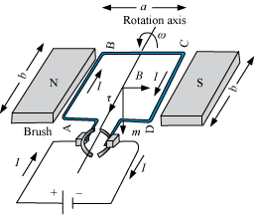

Torque on a current loop, Magnetic Dipole
Consider a rectangular coil ABCD placed in an uniform magnetic field experiences a torque as shown in figure.
Let ‘I’ be the current flowing through the coil.
Each part of the coil experiences one Lorentz .
[$\vec{\text{F}\text{1}}$,$\vec{\text{F}\text{2}}$, $\vec{\text{F}\text{3}}$ and $\vec{\text{F}\text{4}}$ resp.]

Slide 59
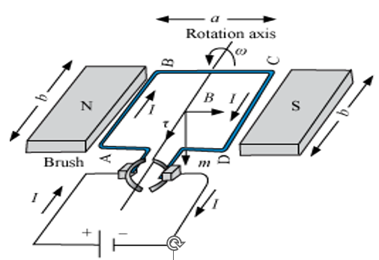
We first consider the simple case then the rectangular loop is placed such that uniform magnetic field B is in the plane of the loop.
The field exerts no force on the two arms AD and BC of the loop. It is perpendicular to the arm AB of the loop and exists a force F₁ on it which directed into the plane of the loop.

Slide 60
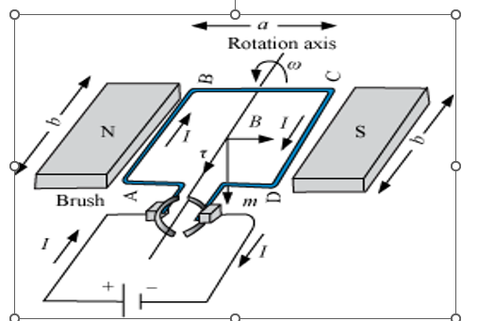
Its magnitude is F₁ = IbB.
Similarly, its exists a force F₂ on the arm CD. And F₂ is directed out of the plane of the paper.
F₂ = IbB = F₁
Thus, the net force on the loop is zero.

Slide 61


There is a torque on the loop due to the pair of forces F₁ and F₂.
The figure shows that the torque on the loop tends to rotate it in anti clock wise direction.
F₂
This torque is,
τ = F₁$\frac{\text{a}}{\text{2}}\text{+}\text{F}\text{2}\frac{\text{a}}{\text{2}}$
a/2
a/2
τ = $\text{IbB}\frac{\text{a}}{\text{2}}\text{ + }\text{IbB} \frac{\text{a}}{\text{2}}\text{=}\text{I}\left(\text{ab}\right)\text{B}\text{ = }\text{IAB}$
m
Where A = ab is the area of the rectangle.
F₁

Slide 62
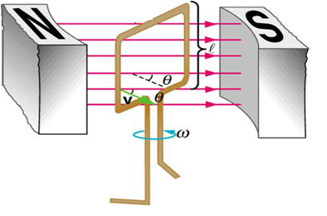
We consider the case when the plane of the loop, is not along the magnetic field but makes an angle with it.
We take the angle between the field and the normal to be angle θ
The previous case θ = π/2.
The forces on the arms BC and DA are equal, opposite, and act along the axes of the coil, which connects the centre of the mass of BC and DA.
The forces being collinear along the axes cancel each other, resulting in no net force or torque

Slide 63
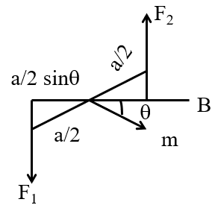
The forces on the arms AB and CD are F₁ and F₂ these are also equal and opposite with magnitude but they are not collinear.
F₁ = F₂ = IbB
This results in a couple as before.
The magnitude of the torque on the loop is τ = F₁ $\frac{\text{a}}{\text{2}} \text{sin}\text{θ + }\text{F}\text{2}\frac{ \text{a}}{ \text{2}} \text{sin}\text{θ}$
Torque is less than the earlier case when plane of loop was along the magnetic field.
= IabB sinθ
F₂
= IAB sinθ
a/2
a/2 sinθ
θ
B
a/2
m
F₁

Slide 64
As θ → 0 , the perpendicular distance between the forces of the couple also approaches zero.
This makes forces collinear and the net force and torque zero.
The torques in the figure can be expressed as vector product of the magnetic moment of the coil and the magnetic field.
Magnetic moment of the current loop is,
M = IA

Slide 65
Where the direction of the area vector A is given by the right hand thumb rule and is directed into the plane of the paper.
Then, as the angle between m and B sin θ can be given as τ = M × B
The dimensions of magnetic moment are [A] [L² ] and its unit is AL².

Slide 66

Qn 32. The radius of a circular loop is r and a current I is flowing in it. The equivalent magnetic moment will be
1. 0.1 J 2. 0.2 J 3. 0.4 J 4. 0.8 J
Qn 33. A circular coil of radius 4cm has 50 turns. In this coil a current of 2A is flowing. It is placed in a magnetic field of 0.1 weber/m² perpendicular to the plane of coil. The amount of work done in rotating it through 180⁰ from its equilibrium position will be
1. Ir 2. 2ir 3. i r² 4.
Qn 34. A small coil of N turns has an effective area A and carries a current I. It is suspended in a horizontal magnetic field B such that its plane is perpendicular to B. The work done in rotating it by
180⁰
about the vertical axis is
1. NAIB 2. 2NAIB 3. 4.

Slide 67
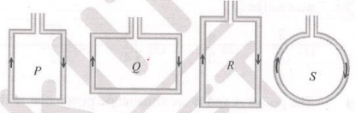
Qn 35. Four wires each of length 2.0 metres are bent into four loops P, Q, R and S and then suspended into uniform magnetic field. Same current is passed in each loop. Which statement is correct
1. Couple on loop P will be the highest
2. Couple on loop Q will be the highest
3. Couple on loop R will be the highest
4. Couple on loop S will be the highest
Qn 36. A triangular loop of side l carries a current I. It is placed in a magnetic field B such that the plane of the loop is in the direction of B. The torque on the loop is
1. Zero 2. IBI 3. 4.

Slide 68
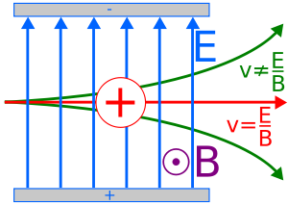
Motion in combined electric and magnetic fields:
Velocity Selector
We know that the charge q moving with velocity v in presence of both electric and magnetic fields experiences a force.
Consider the case in which electric and magnetic fields are perpendicular to each other and also perpendicular to the velocity of the particle.

Slide 69



Let,
y
$\vec{\text{E}}$ = E $\hat{\text{j}}$, $\vec{\text{B}}$ = B $\hat{\text{k}}$, $\vec{\text{v}}$ = v $\hat{\text{i}}$
F_{ba} = I_{b}LB_{a}
F_{E}
E
$\vec{\text{F}\text{B}}$ = q $\vec{\text{v}}$× $\vec{\text{B}}$ = q (v $\hat{\text{i}}$ × B $\hat{\text{k}}$) = -q v B $\hat{\text{j}}$
x
B
V
$\vec{\text{F}}$ = $\vec{\text{F}\text{E}}$+ $\vec{\text{F}\text{B}}$= q(E $\hat{\text{j}}$ - qvB$\hat{\text{j}}$) = q (E-vB) $\hat{\text{j}}$
Z
F_{B}

Slide 70


Thus, the electric and magnetic forces are opposite in direction.
If $\left|\text{F}\text{E}\right|\text{=}\left|\text{F}\text{B}\right|$, the force on charge is zero and it will move undeflected in the field.
This happens when , qE = qvB
v = $\frac{\text{E}}{\text{B}}$
or
Therefore, crossed electric and magnetic fields serve as a velocity selector.

Slide 71
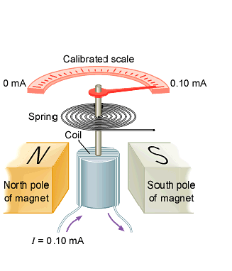
MOVING COIL GALVANOMENTER
A moving coil galvanometer is an instrument used for detection and measurement of small electric currents.

Slide 72
On what principle does moving coil galvanometer work?
A current carrying rectangular loop placed in an uniform magnetic field experiences a maximum torque.
It does not experience a net force.
Construction
It consists of N turns of coil PQRS wound over a non-magnetic metallic frame usually rectangular or circular.
The coil is suspended from a torsion head H by means of phosphor- bronze strip in a magnetic pole by pieces N and S.

Slide 73
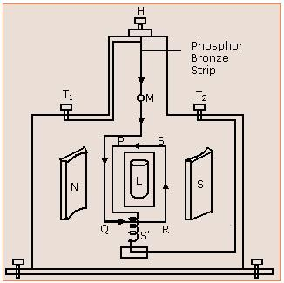
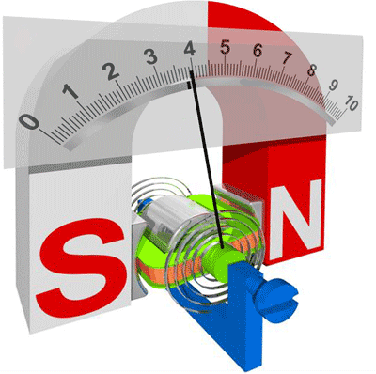
A mirror M is attached to the phosphor – bronze strip.
The other end of the coil is connected to a hairspring, which in turn is connected to an external terminal.
The concave or cylindrical pole pieces ensure that the plane of coil parallel to B, thus (cosθ=1 and Sin a=1) in the expressions,

Slide 74
τ = NIBA cosθ and
τ = NIBA sin a
The whole arrangement is enclosed in a non-magnetic case, which is provided with leveling screws. The torsion head is connected to terminals T₁ and T₂ .

Slide 75
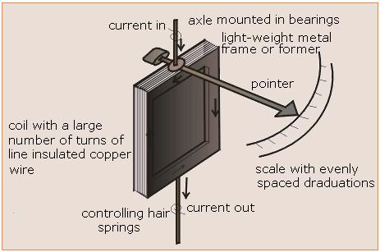
Working
When current is passed through the coils PQRS, the coils experience a torque, τ = NIBA sina
Since the magnetic field is radial, the plane of the coil is parallel to the magnetic field such that a=90⁰ and hence τ = NIBA .

Slide 76



The coil rotates and the phosphor-bronze strip gets twisted.
As a result, a restoring torque comes into play trying to restore the coil back to original position.
Let φ be the twist produced in the strip and C be the restoring torque per unit twist then the restoring torque = Cφ .
In equilibrium, NIBA= $\text{∅}$C
l = $\frac{\text{C}\text{ ∅}}{\text{NBA}}$
  I = Gϕ
  where G = $\frac{\text{C}}{\text{NBA}}$, is called galvanometer constant.
Hence, I α φ
Thus, the galvanometer has a linear scale and detects the presence of current .

Slide 77
CONVERSION OF A GALVANOMETER TO AMMETER
A galvanometer can be converted to an ammeter by connecting a low resistance, called SHUNT (S) in parallel to the galvanometer (G).
What is a shunt?
A low resistance connecting parallel to the galvanometer to protect it from large current is known as shunt.

Slide 78

Let G = R_{G} be the resistance of the galvanometer and S = r_{s} be the shunt resistance
Let R be the effective resistance, then
i = i_{g} + i_{s} → (1)
R =$\frac{\text{R}\text{G}\text{r}\text{s}}{\text{R}\text{G}\text{+}\text{rs}}$ and V=i_{g}R_{G}=i_{s}r_{s}=iR
G=R_{G}
I
I_{g}
I
S=r_{s}
I
–
I_{g}
AMMETER

Slide 79

∴i_{g}R_{G} = i_{s}r_{s}
i_{g}R_{G} = (i-i_{g})r_{s}
∴ i_{s} = i-i_{g} From (1)
i_{g}R_{G} = ir_{s}-i_{g}r_{s}
i_{g}R_{G}+i_{g}r_{s} = ir_{s}
i_{g}(R_{G}+r_{s}) = ir_{s}
i_{g}= $\frac{\text{ir}\text{s}}{\text{(}\text{RG}\text{+}\text{rs}\text{)}}$

Slide 80


Expression for i_{s}: i_{s}= $\frac{\text{iR}\text{G}}{\text{(}\text{RG}\text{+}\text{rs}\text{)}}$
Similarly,
Expression for shunt r_{s}: r_{s}= $\frac{\text{i}\text{g}\text{R}\text{G}}{\text{(}\text{i}\text{−}\text{ig}\text{)}}$
or r_{s} = $\frac{\text{R}\text{G}}{\text{n}\text{−1}}$ where n = $\frac{\text{i}}{\text{i}\text{g}}$ is called the range of ammeter.
So, an ammeter will have a very low resistance.
IDEAL AMMETERS HAVE ZERO RESISTANCE

Slide 81
Why is the parallel resistance smaller than the galvanometer resistance?
The current or total resistance of circuit should not change due to the presence of ammeter. Therefore ammeter should have very low resistance.
If the parallel resistance is smaller than the galvanometer more current flows through the shunt. Hence it can be protected from high currents.

Slide 82

Current Sensitivity
The current sensitivity is defined as the deflection per unit current i.e,
$\frac{\text{φ}}{\text{I}}\text{=}\frac{\text{NBA}}{\text{C}}$radians/rmpere
N should be increased in order to increase sensitivity.

Slide 83
CONVERSION OF GALVANOMETER TO A VOLTMETER
A galvanometer can be converted to a voltmeter by connecting a high resistance ( R) in SERIES.
A voltmeter is used to measure the potential difference between any two points in a circuit.
The voltmeter must always be connected in parallel in the circuit.
G=R_{G}
R
I_{g}
I_{g}
V_{g}
V_{R}
V
Voltmeter

Slide 84



The value of the series resistance ‘R’ to be connected to convert galvanometer into a voltmeter is R = r + R_{G .}
Let R_{G} be the resistance of the galvanometer and r be the parallel resistance and R be the effective resistance.
The potential difference between A and B
V = i_{g} [ r + R_{G} ]
V = i_{g}r + i_{g}R_{G}
r = $\frac{\text{V}}{\text{i}\text{g}}\text{−}\text{R}\text{G}\text{=}\text{RG}\left[\frac{\text{V}}{\text{i}\text{g}\text{R}\text{G}}\text{−1}\right]$
r = R_{G} $\left[\text{n}\text{−1}\right]$
where n=$\frac{\text{V}}{\text{i}\text{g}\text{R}\text{G}}$ is called the range of the voltmeter.

Slide 85
This works as a voltmeter of range 0 to V volts.
Thus voltmeters have high resistance.
AN IDEAL VOLTMETER HAS INFINITE REISISTANCE.
Conductance of an ideal voltmeter is zero.
High resistance of voltmeter does not affect the potential difference measured it draws a very small current.
Ex:
Potentiometer is an ideal voltmeter.

Slide 86

Voltage Sensitivity
Voltage Sensitivity is defined as the deflection produced for a unit voltage applied across the two terminals of the galvanometer.
$\frac{\text{φ}}{\text{V}}\text{=}\frac{\text{φ}}{\text{IR}}\text{=}\frac{\text{NBA}}{\text{C}\text{R}}$radians / volt
To make the field radial in a moving coil galvanometer
1. The number of turns in the coil is increased
2. Magnet is taken in the form of horse-shoe
3. Poles are cylindrically cut
4. Coil is wounded on aluminium frame

Slide 87
Qn 37. Current sensitivity of a moving coil galvanometer is 5 div/mA and its voltage sensitivity (angular deflection per unit voltage applied) is 20 div/V. The resistance of the galvanometer is
1. 250 2. 25 3. 40 4. 500
Qn 38. In a moving coil galvanometer, the deflection of the coil
is related to the electrical current I by the relation
11. 2. 3. 4.

Slide 88

Thank you…

